Slide 1
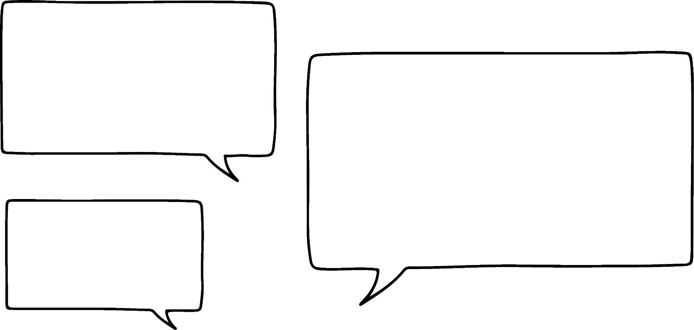




Generating a sequence using a position-to-term rule
Task A: Writing position-to-term rules
For each sequence, write a position-to-term rule for the number of dots in each pattern.
a)
c)
Term number | 1 | 2 | 3
Term | 6 | 11 | 16
Term number | 1 | 2 | 3
Term | 7 | 13 | 19
Rule: ‘term number × 5 + 1’
Rule: ‘term number × 6 + 1’
b)
d)
Term number | 1 | 2 | 3
Term | 7 | 11 | 15
Term number | 1 | 2 | 3
Term | 4 | 8 | 12
Rule: ‘term number × 4 + 3’
Rule: ‘term number × 4’
2) Four students are writing a position-to-term rule for the sequence:
9, 11, 13, … Who is correct?
For the incorrect answers, show how you know they are incorrect.
The term is the term number multiplied by 9
The term is the term number add 2
Sam: 1 × 9 = 9
But 2 × 9 is not 11
Sofia: The term-to-term rule could be add 2.
But 1 + 2 ≠ 9, 2 + 2 ≠ 11…
The term number add 2 is not the correct rule.
Sam
Sofia
The term is the term number multiplied by 2 add 7
The term is the term number multiplied by 2 add 9
Alex is correct. T₁= 2 + 7, T₂= 2 + 2 + 7, T₃= 2 + 2 + 2 + 7
Alex
Izzy
Izzy: 1 × 2 + 9 ≠ 9
and 2 × 2 + 9 ≠ 11

Slide 2
Generating a sequence using a position-to-term rule
Task B: Generating terms from position-to-term rules
For each sequence, find the value of T₆₀
Each term is the term number multiplied by 5 plus 6 T₆₀= 306
Each term is the term number halved then add 2 T₆₀= 32
Each term is the term number subtract 5 T₆₀= 55
Each term is 10 less than the term number then multiplied by 3 T₆₀= 150
12, 15, 18, 21, …. (with a constant additive pattern) T₆₀= 189
18, 19, 20, 21, … (with a constant additive pattern) T₆₀= 77
1.4, 1.8, 2.2, 2.6, … (with a constant additive pattern) T₆₀= 25
Mathematics in Education and Industry
v2.2

